Slide 1

SMART HOME WITH IOT AND ML
WASTE FELLOWS

Slide 2
Bulb
Anomaly detection algorithms
Summary report
Prompt user to buy likely to fail items

Slide 3
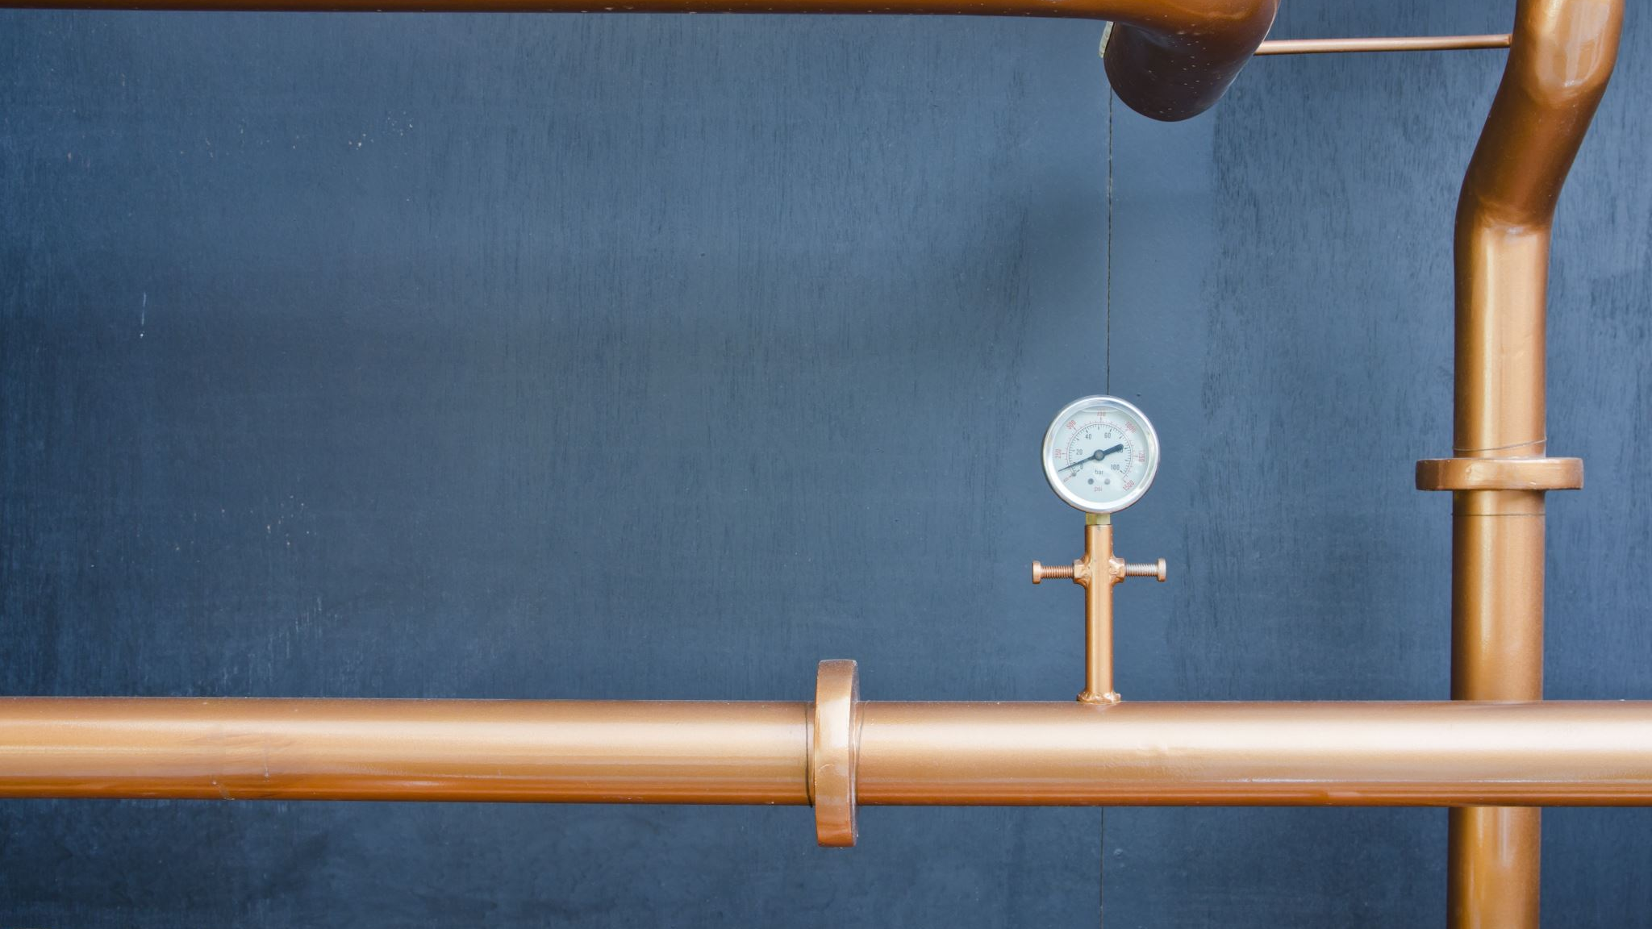
Water Heater
Outside Temperature and Weather
Time of the day
Sync with Calendar
Learning from mixing cold water
Quantity of Water

Slide 4

Refrigerator
Medical box becoming empty
Make a list of medicine the user is taking
Learning how much quantity is being consumed
Fingerprint authorisation and behaviour based on that (alerts)
Prompt to place order to user

Slide 5
MORE TO IT
Sensor at door
Studying pattern of his behaviour
Example: A study room
Example: Sweeping Robot

